Slide 1
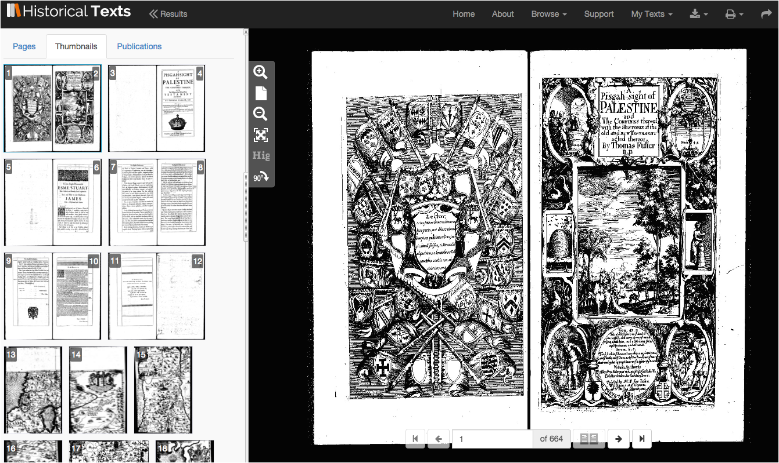

Introduction to Historical Texts
Over 350, 000 late 15th to long 19th century texts (EEBO, ECCO & BL 19th Century)

Slide 2
What is Historical Texts?
Historical Texts is a full text digital archive enabling you to cross search, view and download over 350,000 texts published in the late C15th to the long C19th.
It contains three collections:
Early English Books Online (EEBO) (1473-1700)
Eighteenth Century Collections Online (ECCO) (1701-1800)
65,000 texts from the British Library 19th Century collection (1789-1914)
Including a wealth of content ranging from the Romantic to the Victorian period and coverage subject areas including English literature, history, geography, science, social science, religion and medicine.
Materials include books, pamphlets, sermons, almanacs, sheet music, broadsides, newsbooks.

Slide 3
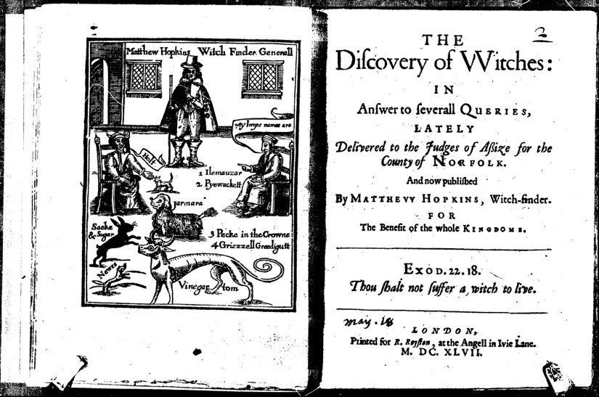
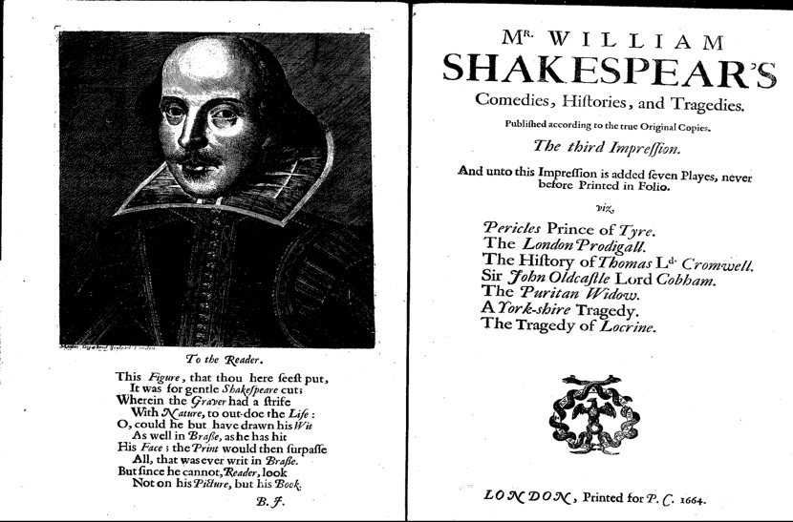
Early English Books Online (EEBO)
(1473-1700)
The scanned images, and full-text digital versions where available, of over 125,000 books printed in Britain and British North America, and works in English printed elsewhere, from the first book published in England up to 1700.
Authors include Shakespeare, Galileo, Bacon, Chaucer, Spenser and Margaret Cavendish.

Slide 4
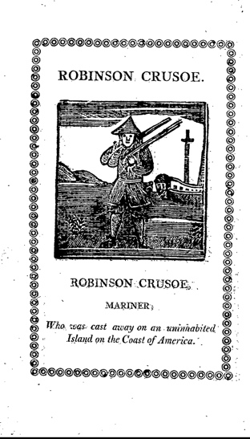
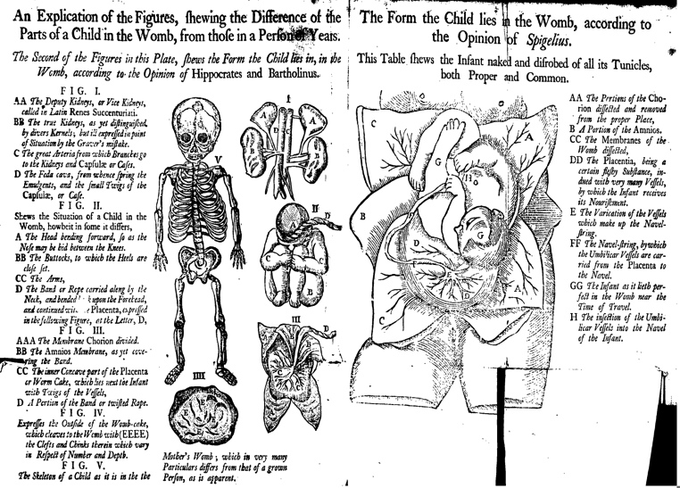
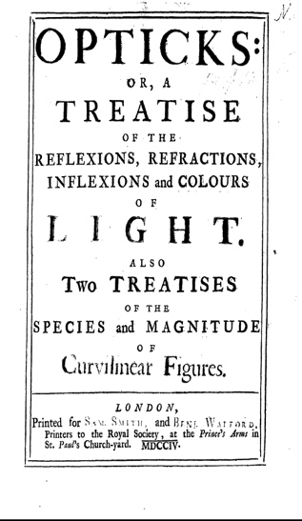
Eighteenth Century Collections Online (ECCO)
(1701-1800)
A digital collection of more than 180,000 titles published in Great Britain and its colonies during the eighteenth century, including works in languages other than English (e.g. French, German, Latin and Welsh)
Works include Daniel Defoe, Newton, Culpepper, Alexander Pope, Thomas Paine, Voltaire.

Slide 5
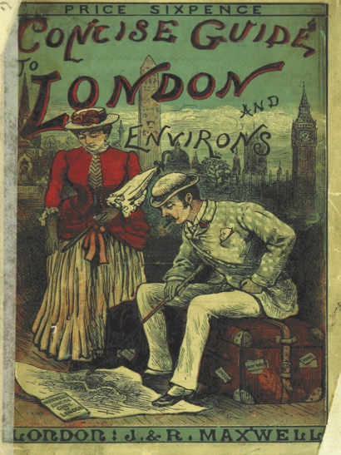
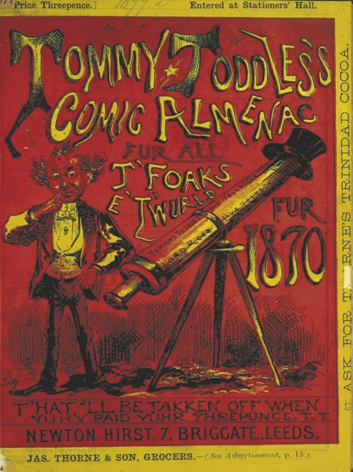
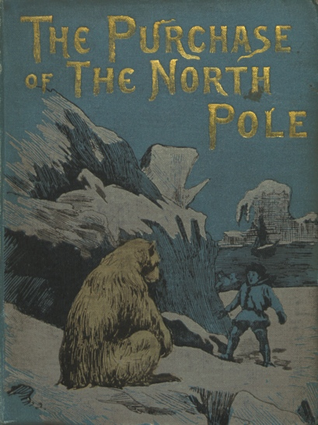
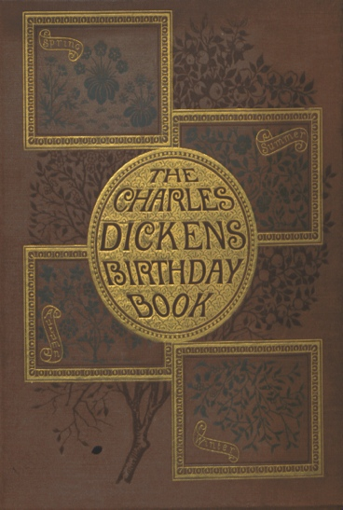
65,000 British Library 19th century texts
(1789-1914)
Over 65,000 recently digitised editions from the British Library's 19th century collection, comprising over 25 million pages of previously rare and inaccessible titles.
Authors include Jane Austen, Charles Dickens, Jules Verne

Slide 6
Key features
Cross-search EEBO, ECCO and 65, 000 texts from the British Library C19th collection for the first time
View and search the full text (where available) as well as the bibliographic information for texts
View images and full text side by side
Download whole publications (PDF) and individual images (JPEG)
View publication date histogram for search results

Slide 7
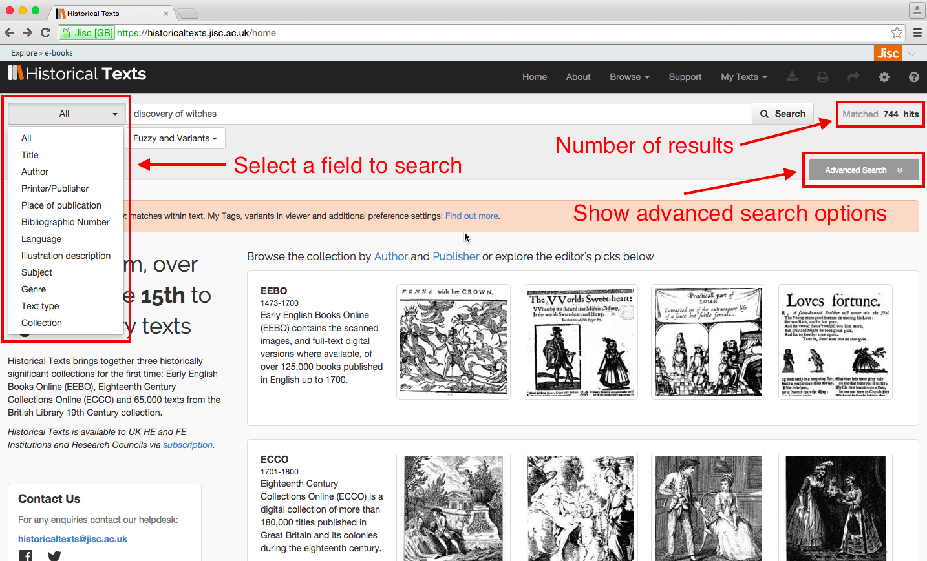
Search

Slide 8
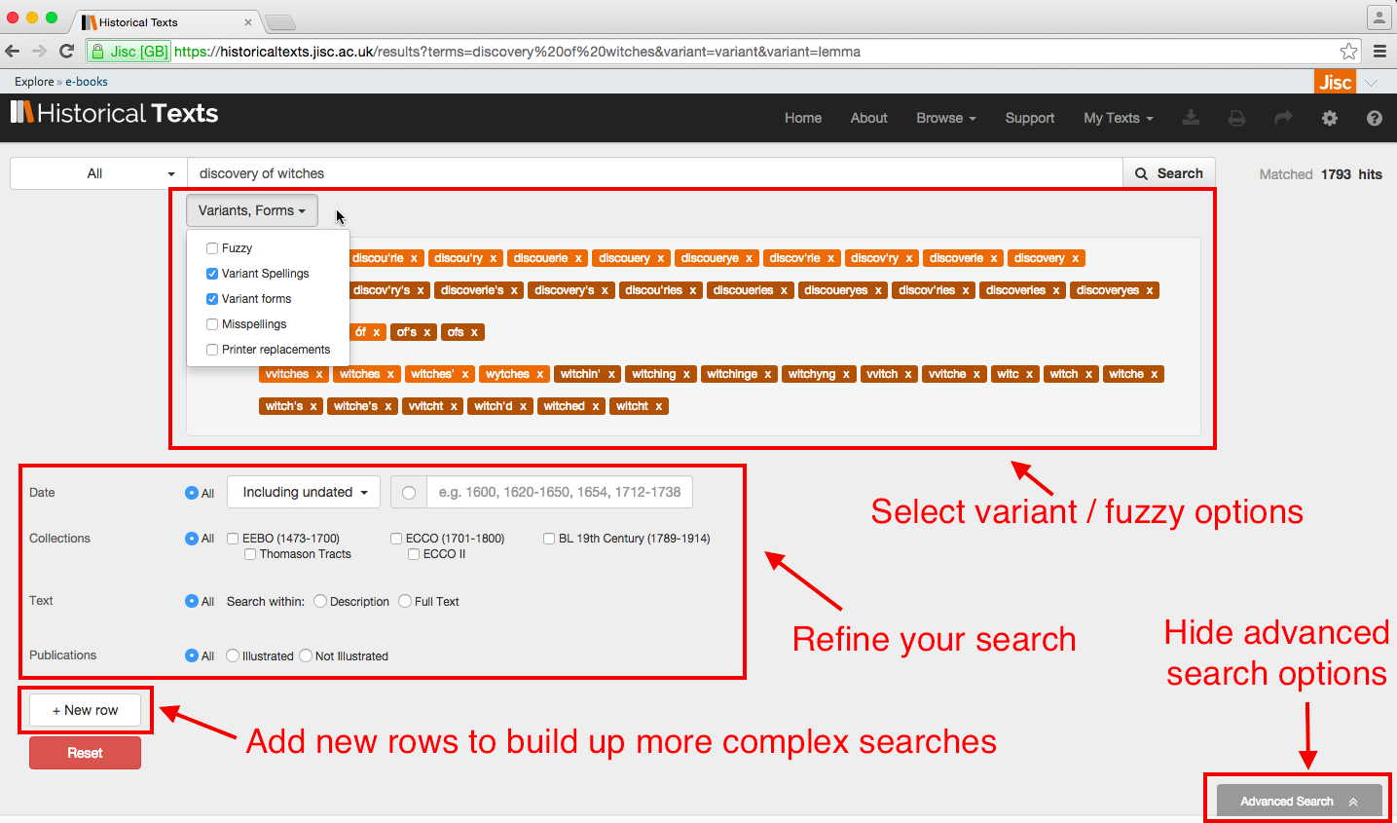
Advanced search

Slide 9
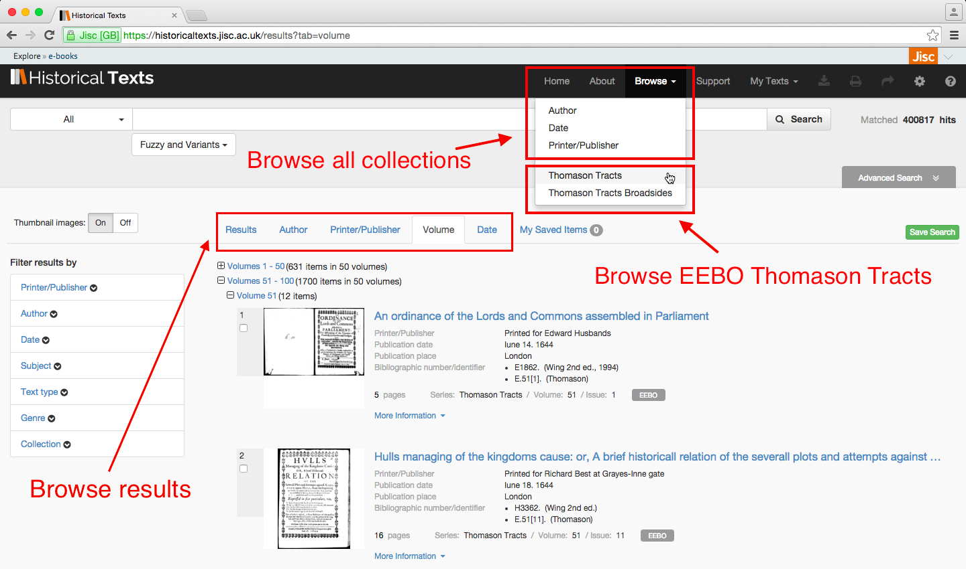
Browse

Slide 10
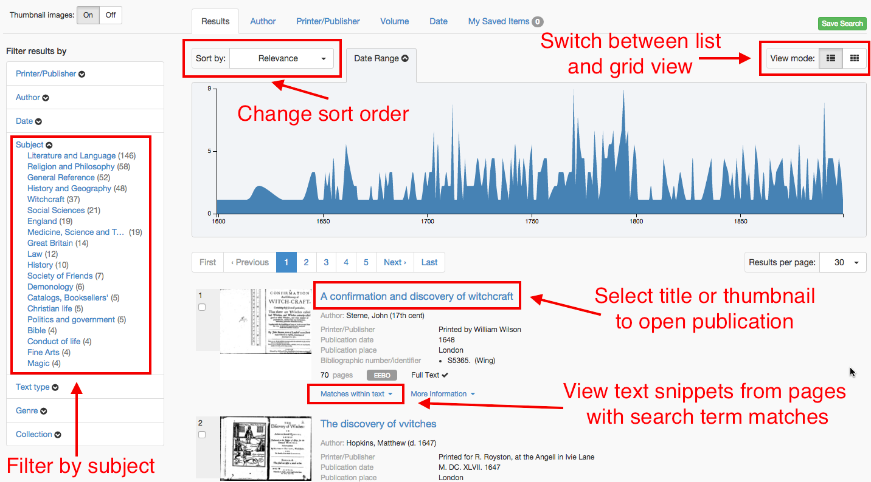
Results

Slide 11
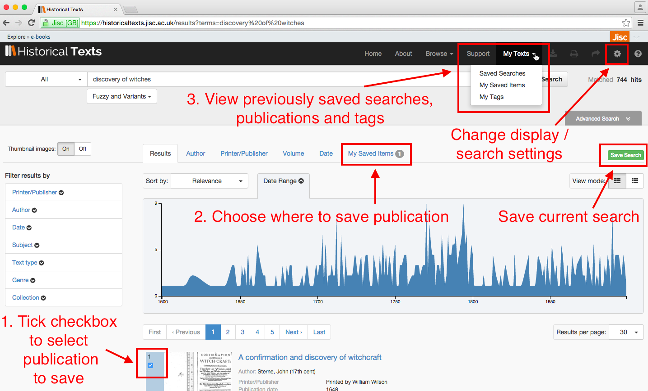
Saving searches, items and settings

Slide 12
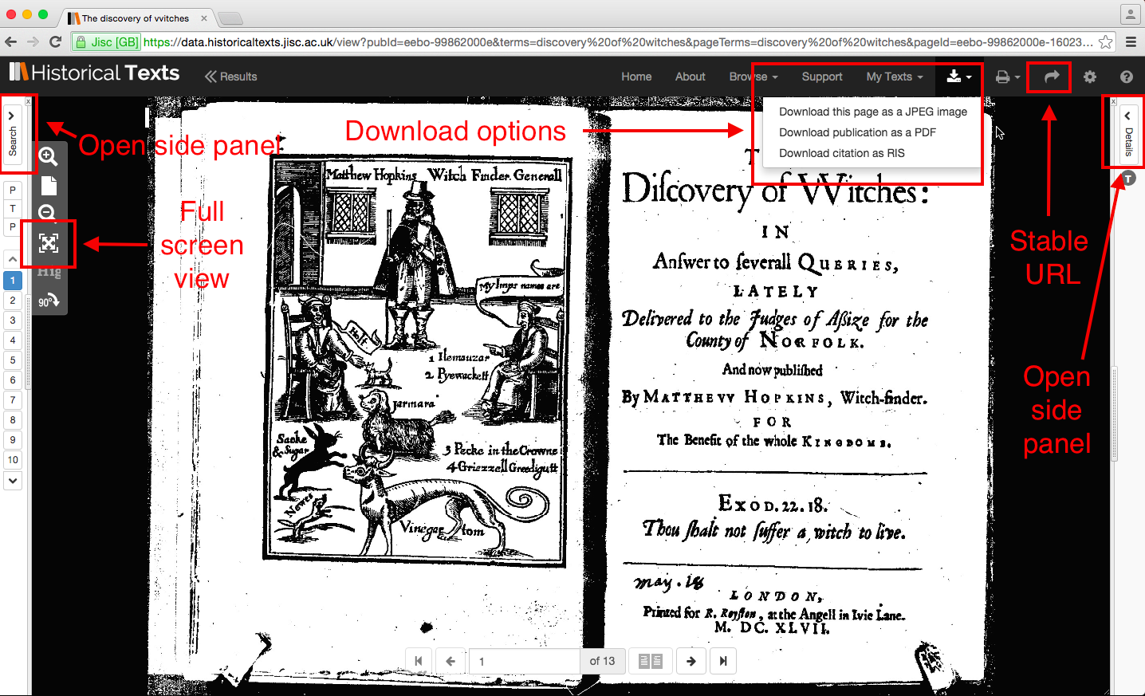
Viewer

Slide 13
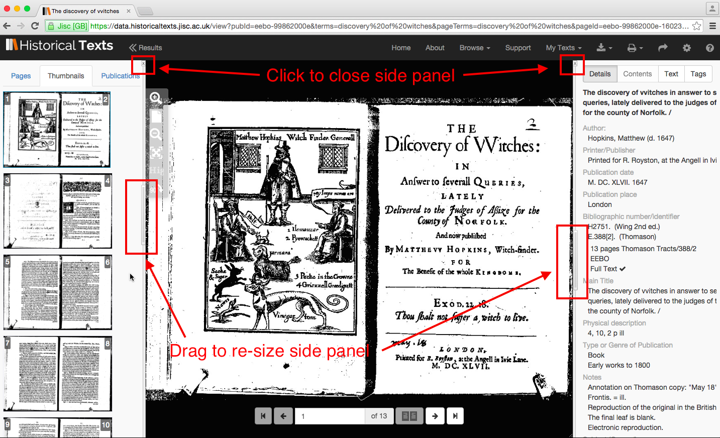
Viewer (side panels open)

Slide 14
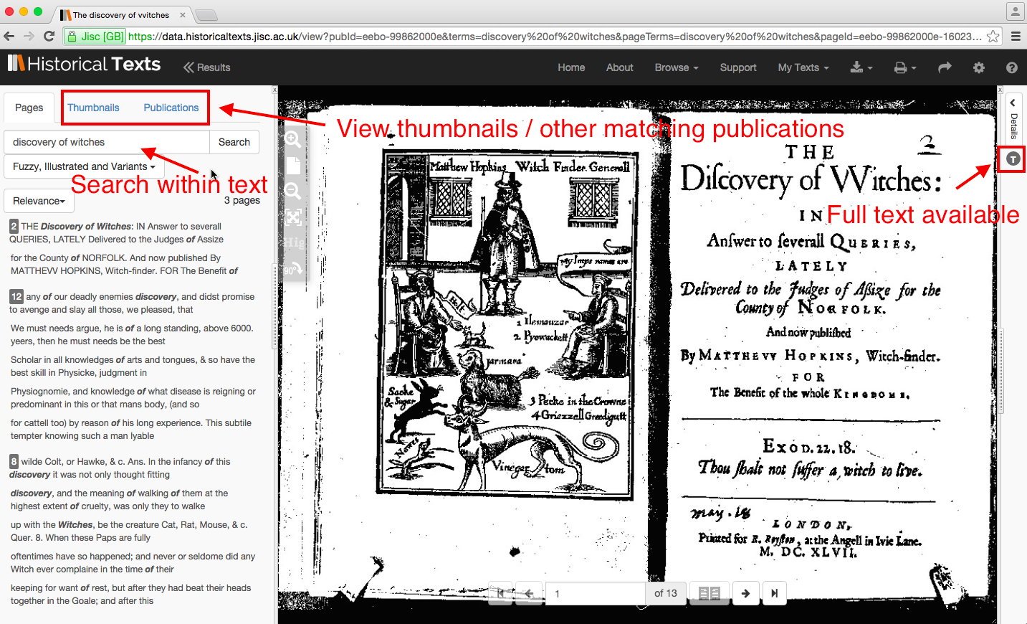
Viewer (search panel)

Slide 15
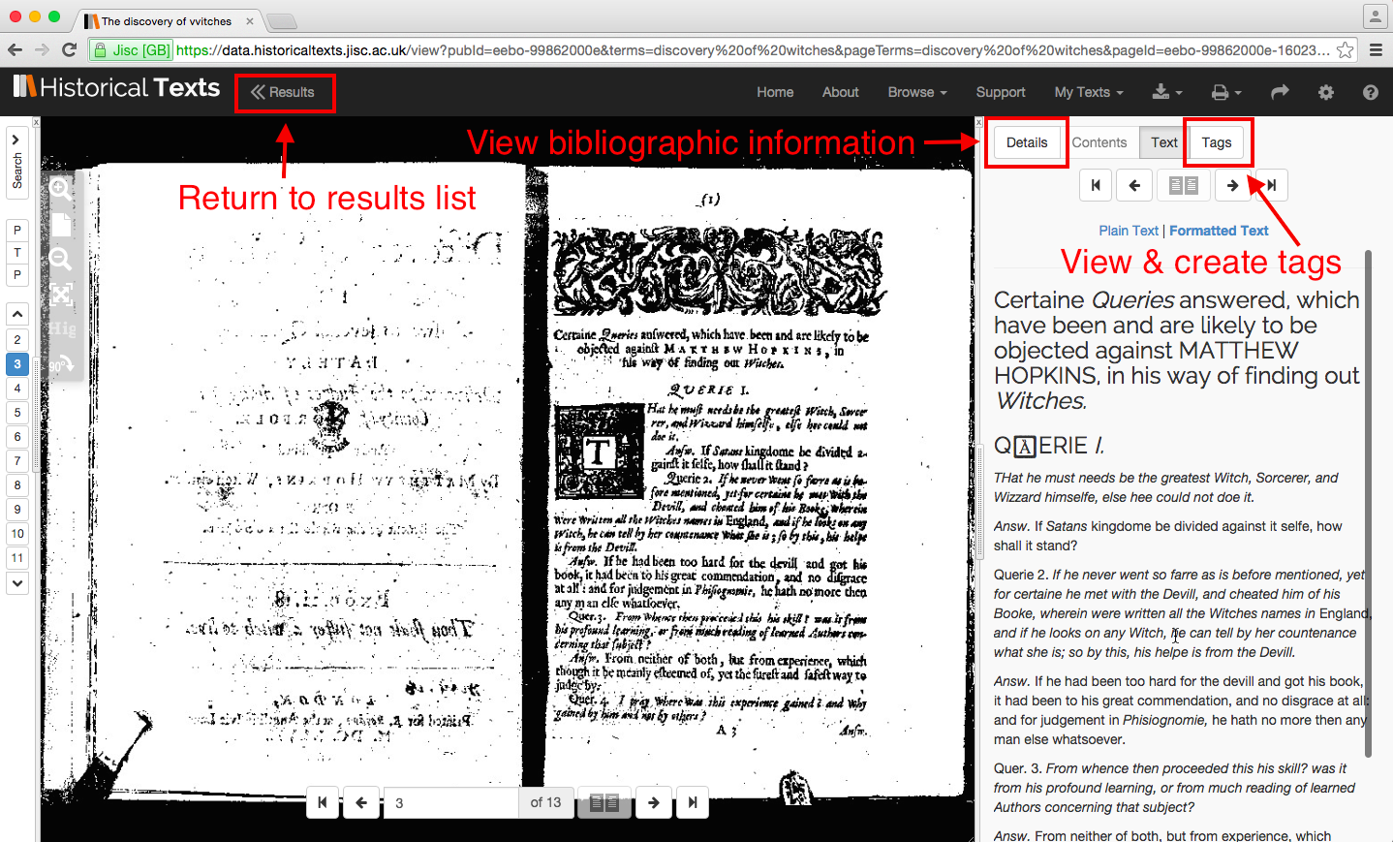
Viewer (details panel)

Slide 16
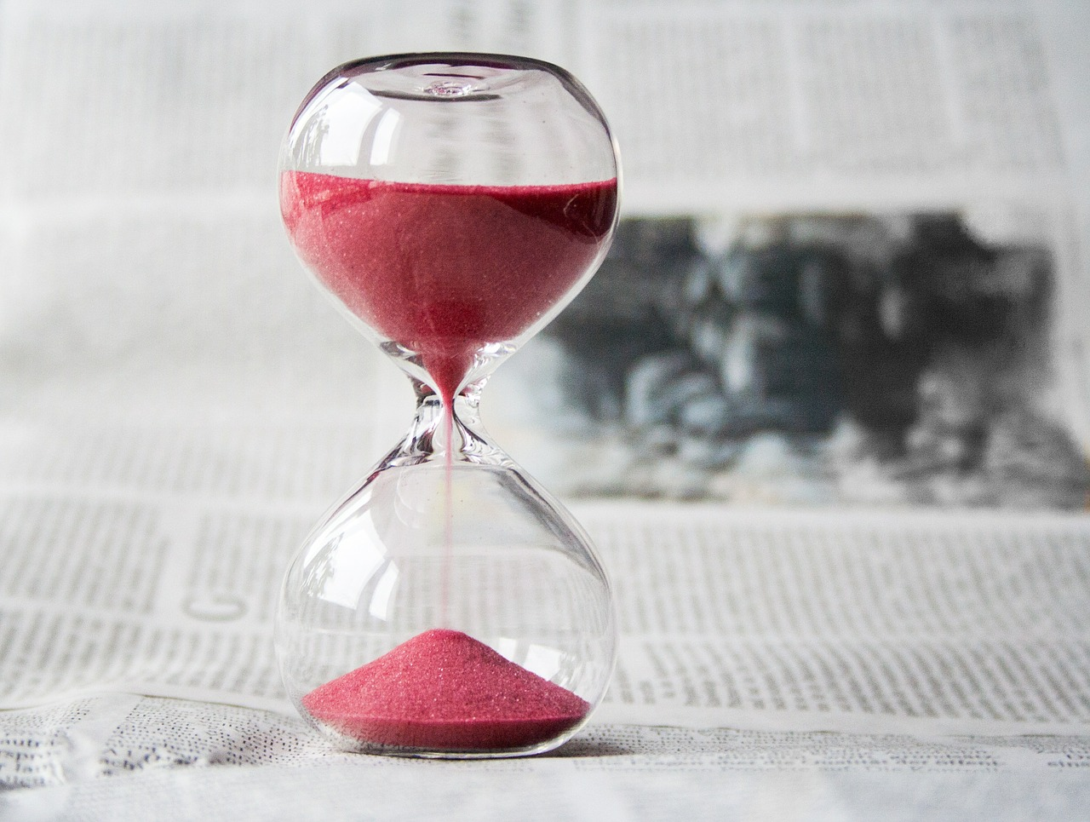
Benefits for researchers
Time saving – reducing need to travel to holding libraries to view texts
Access to rare and, in some cases, previously inaccessible texts
Full text searching across the 65,000 texts from the BL C19th collection for the first time
View ECCO full text for the first time
Cross search EEBO, ECCO and 65,000 BL 19th century texts in one place to quickly discover related material
View full text and images side by side for first time

Slide 17
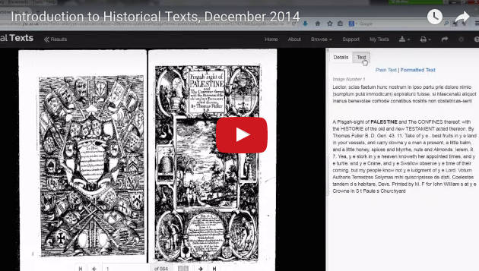
Further information
Website: http://historicaltexts.jisc.ac.uk
Support materials: http://historicaltexts.jisc.ac.uk/support
Development roadmap: http://historicaltexts.jisc.ac.uk/developmentroadmap
Helpdesk: historicaltexts@jisc.ac.uk

